Slide 1


Day 1 Introduction To Dart
MARLON I. TAYAG

Slide 2

What is Dart?
Dart is an object-oriented language with C-style syntax which can optionally trans compile into JavaScript. It supports a varied range of programming aids like interfaces, classes, collections, generics, and optional typing.
Notes:
Dart was created by Google, like Flutter,…and its main purpose was…to be able to leverage C-based language…and create a language that is fast in compile time,…concise, and easy to learn.…You can use Dart to create mobile applications with Flutter,…create web applications,…and even server-based applications with Dart VM

Slide 3
History of Dart
Dart was unveiled at the GOTO conference in Aarhus, Denmark, October 10–12, 2011. The project was founded by Lars Bak and Kasper Lund. Dart 1.0 was released on November 14th, 2013. In August 2018, Dart 2.0 was released, with language changes including a sound type system.
Dart 2.4.0

Slide 4

Goal of Dart
Help developers write complex, high fidelity client apps for the modern mobile and web applications.

Slide 5

Native Mobile Apps
Google has introduced Flutter for native mobile app development on both Android and iOS. Flutter is a mobile app SDK, complete with framework, widgets, and tools, that gives developers a way to build and deploy mobile apps, written in Dart.

Slide 6
DartPad Editor
The Dart team created DartPad at the start of 2015, to provide an easier way to start using Dart. It is a fully online editor from which users can experiment with Dart application programming interfaces (APIs), and run Dart code. It provides syntax highlighting, code analysis, code completion, documentation, and HTML and CSS editing
https://dartpad.dartlang.org/

Slide 7
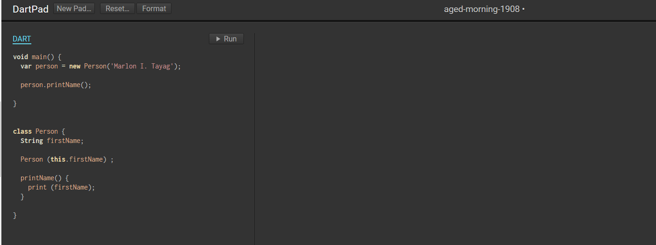

Slide 8
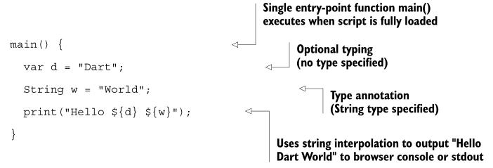
Language Syntax
Notes:
The language syntax is very similar to Java, C#, and JavaScript. One of the primary goals for Dart was that the language seem familiar. This is a tiny Dart script, comprising a single function called main :

Slide 9

Hello Word

Slide 10
main()
This line declares a function called main(). In short, they are a block of statements that the computer executes when the function is “called.” They are like a page in an instruction manual that can be turned to anytime. main() is always the entry point of a Dart program—the place where the program begins execution. main() is automatically called (executed).
Notes:
The main() function is a predefined method in Dart. This method acts as the entry point to the application. A Dart script needs the main() method for execution. print() is a predefined function that prints the specified string or value to the standard output i.e. the terminal.
This line declares a function called main(). In short, they are a block of statements that the computer executes when the function is “called.” They are like a page in an instruction
manual that can be turned to anytime. main() is always the entry point of a Dart program—the place where the program begins execution. main() is automatically called (executed).

Slide 11
Identifiers in Dart
Identifiers are names given to elements in a program like variables, functions etc. The rules for identifiers are :
Identifiers can include both, characters and digits. However, the identifier cannot begin with a digit.
Identifiers cannot include special symbols except for underscore (_) or a dollar sign ($).
Identifiers cannot be keywords.
They must be unique.
Identifiers are case-sensitive.
Identifiers cannot contain spaces.

Slide 12
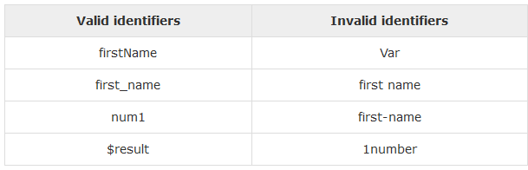
Notes:
The following tables lists a few examples of valid and invalid identifiers

Slide 13
Keywords in Dart
Keyword is a word that is reserved by a program because the word has a special meaning. Keywords can be commands or parameters. Every programming language has a set of keywords that cannot be used as variable names. Keywords are sometimes called reserved names :
Reserved Words
Contextual Keywords
Built-in Identifiers

Slide 14
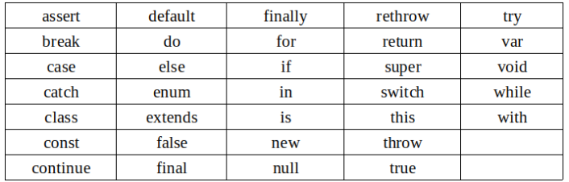
Reserved Words
Following are the reserved words in dart. These reserved words cannot be used as identifiers.

Slide 15
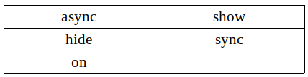
Contextual Keywords
These keywords have meaning only in specific places. In other places they are valid identifiers.

Slide 16
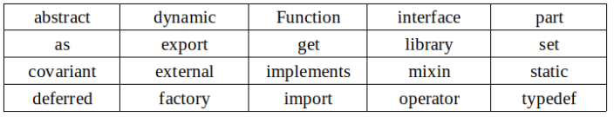
Built-in Identifiers
These keywords are valid identifiers in most places, but they can’t be used as class or type names, or as import prefixes.

Slide 17
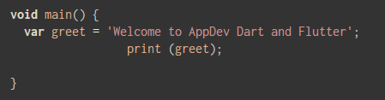
Whitespace and Line Breaks
Dart ignores spaces, tabs, and newlines that appear in programs. You can use spaces, tabs, and newlines freely in your program and you are free to format and indent your programs in a neat and consistent way that makes the code easy to read and understand. But it is better to follow coding and alignment rules

Slide 18
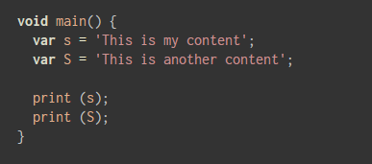
Dart is Case-sensitive
Dart is case-sensitive. This means that Dart differentiates between uppercase and lowercase characters.

Slide 19
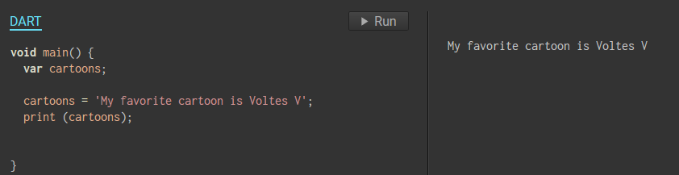
Statements end with a Semicolon
Each line of instruction is called a statement. Each dart statement must end with a semicolon (;). A single line can contain multiple statements. However, these statements must be separated by a semicolon.
semicolon

Slide 20
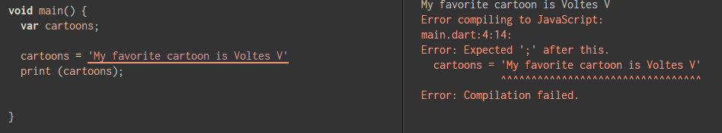

Slide 21
Comments in Dart
Comments are a way to improve the readability of a program. Comments can be used to include additional information about a program like author of the code, hints about a function/ construct etc. Comments are ignored by the compiler.
Dart supports the following types of comments :
Single-line comments ( // ) − Any text between a "//" and the end of a line is treated as a comment
Multi-line comments (/* */) − These comments may span multiple lines.

Slide 22
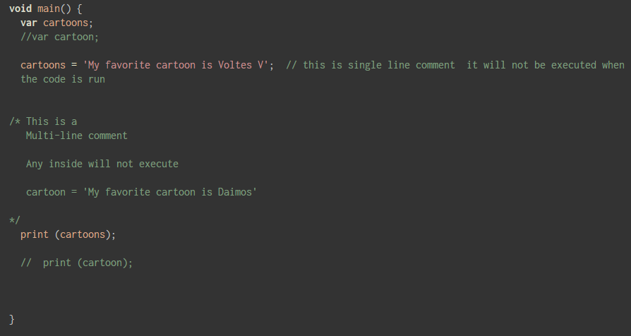

Slide 23

Variables
Variables are a basic building block of most modern programs. In short, a variable is an alias for a computer memory location, at which something of interest will be stored. Whatever is stored there is said to be the variable's value.
Notes:
If you've studied the basics of algebra, you might remember variables mostly as single-letter stand-ins for numbers that helped you conceptualize and solve complex equations. Dart's variables are similar but not exactly the same, as they're capable of standing in for all kinds of values: numbers, strings of characters, or even more complex structures representing people, economic transactions, or geographic locations.
The first line of main() declares a variable called x using Dart's var keyword. When this line is executed, Dart sets aside a place in memory for a value, and you can later make use of that value by its name, x. In this case, you send the value to the print() function in order to see it printed to your system console.
All declared variables in Dart are initially given the special value of null. This means the variable is uninitialized. It has no value. Even 0 (zero) would be a value, but null really is, in programming terms, nothing. This is why you see null in the console when you print the value of x.

Slide 24
Variables
A variable is “a named space in the memory” that stores values. In other words, it acts a container for values in a program. Variable names are called identifiers. Following are the naming rules for an identifier:
Identifiers cannot be keywords.
Identifiers can contain alphabets and numbers.
Identifiers cannot contain spaces and special characters, except the underscore (_) and the dollar ($) sign.
Variable names cannot begin with a number.

Slide 25
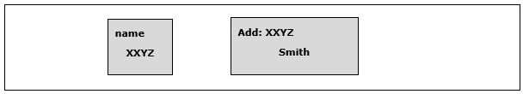
Type Syntax
A variable must be declared before it is used. Dart uses the var keyword to achieve the same. The syntax for declaring a variable is as given below:
var name = 'Smith';
Notes:
All variables in dart store a reference to the value rather than containing the value. The variable called name contains a reference to a String object with a value of “Smith”.

Slide 26

Initialize Variable
As null is not a very useful value for your variable, try initializing it with a numeric value, like so:
Notes:
Unlike in algebra class, the = operator in Dart does not strictly represent equivalence. It's known as the assignment operator, so x = 5 is an expression instructing the computer to assign the value 5 to a memory location named x. Then, when you print x, the result is 5.

Slide 27
Dart Programming - Data Types
One of the most fundamental characteristics of a programming language is the set of data types it supports. These are the type of values that can be represented and manipulated in a programming language.
The Dart language supports the following types:
Numbers
Strings
Booleans
Lists
Maps
Notes:
Variables in Dart come in many different types. Some variables are meant to hold numbers, some characters, and some point to more complex values. When declaring variables, you can allow Dart to attempt to infer your variable's intended type or you can be explicit.

Slide 28
Numbers
Numbers in Dart are used to represent numeric literals. The Number Dart come in two flavours:
Integer − Integer values represent non-fractional values, i.e., numeric values without a decimal point. For example, the value "10" is an integer. Integer literals are represented using the int keyword.
Double − Dart also supports fractional numeric values i.e. values with decimal points. The Double data type in Dart represents a 64-bit (double-precision) floating-point number. For example, the value "10.10". The keyword double is used to represent floating point literals.

Slide 29
Strings
Strings represent a sequence of characters. For instance, if you were to store some data like name, address etc. the string data type should be used.
The keyword String is used to represent string literals. String values are embedded in either single or double quotes.

Slide 30
Boolean
The Boolean data type represents Boolean values true and false. Dart uses the bool keyword to represent a Boolean value.

Slide 31


List and Map
The data types list and map are used to represent a collection of objects. A List is an ordered group of objects. The List data type in Dart is synonymous to the concept of an array in other programming languages. The Map data type represents a set of values as key-value pairs. The dart: core library enables creation and manipulation of these collections through the predefined List and Map classes respectively.
Notes:
List or array of similar items is used in all programming languages.In dart, this is represented by array or commonly known as lists. List is an ordered group of objects. The index of the list starts from 0.So, the index of the first element is 0,second element is 1 etc. Using this index,we can access any value for a specific position in the list.Creating a simple looks like as below :

Slide 32
Inferred Types
var x;
When you declare a variable using var, Dart tries to infer the variable's type. If you don't initialize the new variable with a value in the same statement as the declaration, Dart has nothing on which to base an inference, so the variable is considered to be of type dynamic. As a dynamic variable, x is able to accept values of any valid type.
Notes:
Dart is an optionally typed language. If the type of a variable is not explicitly specified, the variable’s type is dynamic. The dynamic keyword can also be used as a type annotation explicitly.

Slide 33
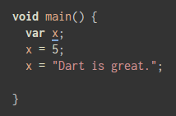
Notes:
In this example, the type of the variable called x is declared but not initialized with a value, and becomes dynamic, so code like this wouldn't be a problem:
The code declares x, then instructs Dart to store a value of 5 at the memory location aliased as x. That value is an integer, a whole number with no fractional part. The next line assigns the value "Dart is great.", a string of characters, to x. That's a versatile variable.

Slide 34
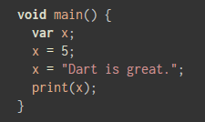
Notes:
Can you predict what will be printed? If you run the code, you'll see that "Dart is great." appears in the console. What happened to the 5? After x was declared, it was assigned the value 5, but the next instruction assigned a string of characters to x, obliterating the numeric value. Since x is of type dynamic, the code analyzer does not flag the potential issue.

Slide 35
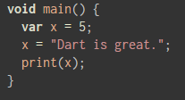
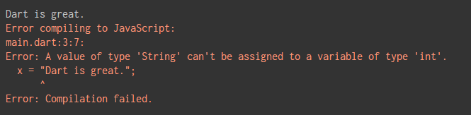
Notes:
This code causes DartPad to display an error, saying that you're mixing types. Because you've initialized x with an integer number value at the same time you declared it, Dart infers that x is supposed to hold integers from that point on. Now x is of type int.
You can override Dart's inference by specifying that you want your variable to be dynamic. Try changing the declaration to look like this and see the error disappear:
dynamic x = 5;

Slide 36
Type-Checking
Dart supports type-checking by prefixing the variable name with the data type. Type-checking ensures that a variable holds only data specific to a data type. The syntax for the same is given below:
void main() {
String name = ‘Skee’;
int num = 10;
}
Notes:
void main() {
String name = 'Smith';
int num = 10;
}

Slide 37
Errors Stop Execution
Note that if you run the code with mismatched types, execution will fail. You should always eliminate all reported errors before attempting to run your code.

Slide 38

What is the problem?

Slide 39

The Dynamic Keyword
Variables declared without a static type are implicitly declared as dynamic. Variables can be also declared using the dynamic keyword in place of the var keyword.

Slide 40
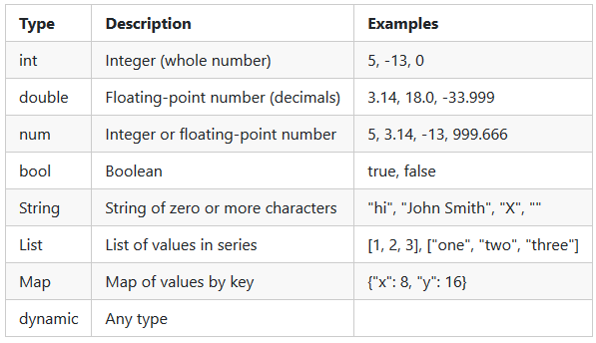
Fundamental Types

Slide 41
var Recap
Remember, if you declare a variable with var, but don't assign a value in the same statement, Dart will assume it should be dynamic, but if you do initialize the value as you declare the variable, Dart will infer the type based on that value's type. So the following two lines are equivalent:
var z;
dynamic z;
var y = 99;
int y = 99;

Slide 42
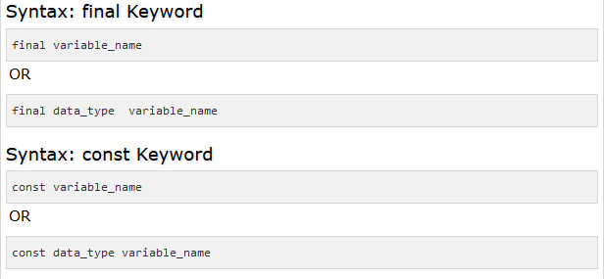
Final and Const
The final and const keyword are used to declare constants. Dart prevents modifying the values of a variable declared using the final or const keyword. These keywords can be used in conjunction with the variable’s data type or instead of the var keyword.
The const keyword is used to represent a compile-time constant. Variables declared using the const keyword are implicitly final.

Slide 43
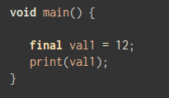

Slide 44
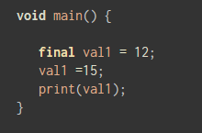
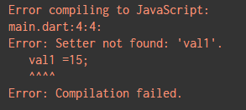
What caused the error?

Slide 45
Operators
An expression is a special kind of statement that evaluates to a value. Every expression is composed of:
Operands − Represents the data
Operator − Defines how the operands will be processed to produce a value.
Notes:
Consider the following expression – "2 + 3". In this expression, 2 and 3 are operands and the symbol "+" (plus) is the operator.

Slide 46
Types of Operators
Arithmetic Operators
Equality and Relational Operators
Type test Operators
Bitwise Operators
Assignment Operators
Logical Operators

Slide 47
Arithmetic Operators
Operator | Meaning
+ | Add
- | Subtract
-expr | Unary minus, also known as negation (reverse the sign of the expression)
* | Multiply
/ | Divide
~/ | Divide, returning an integer result
% | Get the remainder of an integer division (modulo)
++ | Increment
-- | -- Decrement

Slide 48
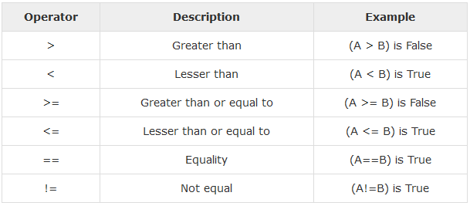
Equality and Relational Operators
Relational Operators tests or defines the kind of relationship between two entities. Relational operators return a Boolean value i.e. true/ false.
Assume the value of A is 10 and B is 20.

Slide 49
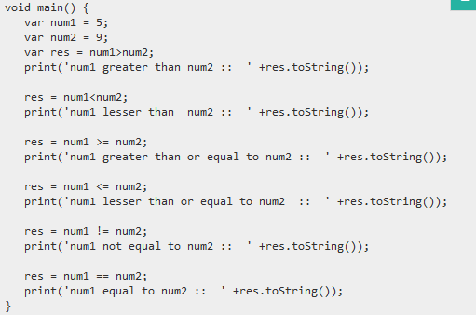

Slide 50
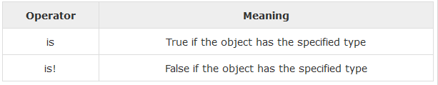
Type test Operators
These operators are handy for checking types at runtime.

Slide 51




Slide 52
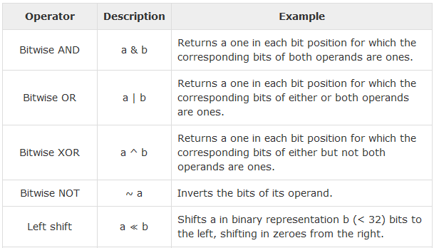
Bitwise Operators
Bitwise operators are operators (just like +, *, &&, etc.) that operate on ints and uints at the binary level.

Slide 53
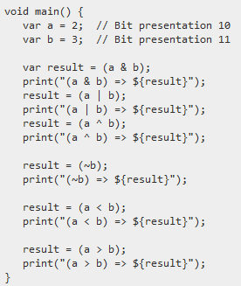
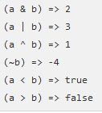

Slide 54
Assignment Operators
Operations that allow the assignment of value to a variable
Sr.No | Operator & Description
1 | =(Simple Assignment ) Assigns values from the right side operand to the left side operand Ex: C = A + B will assign the value of A + B into C
2 | ??= Assign the value only if the variable is null
3 | +=(Add and Assignment) It adds the right operand to the left operand and assigns the result to the left operand. Ex: C += A is equivalent to C = C + A

Slide 55
Assignment Operators
Sr.No | Operator & Description
4 | ─= (Subtract and Assignment) It subtracts the right operand from the left operand and assigns the result to the left operand. Ex: C -= A is equivalent to C = C – A
5 | *= (Multiply and Assignment) It multiplies the right operand with the left operand and assigns the result to the left operand. Ex: C *= A is equivalent to C = C * A
6 | /= (Divide and Assignment) It divides the left operand with the right operand and assigns the result to the left operand.

Slide 56
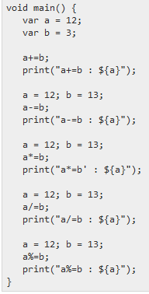
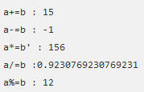

Slide 57
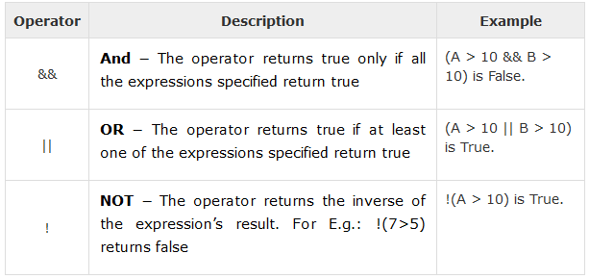
Logical Operators
Logical operators are used to combine two or more conditions. Logical operators return a Boolean value. Assume the value of variable A is 10 and B is 20.

Slide 58
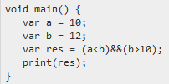
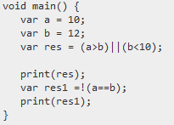

&& and ||
Notes:
The && and || operators are used to combine expressions. The && operator returns true only when both the conditions return true.

Slide 59
Conditional Expressions
Notes:
Often in programming, it is necessary to enable the machine to make a decision.

Slide 60

Notes:
The statements within the curly braces of an if-statement will only be executed if the statement inside of its
parentheses is true. In this case, “It is hot today.” will only be printed to the console if the variable temperature holds
a value greater than 75. > is an operator for comparison that means “greater than.” If it’s not hot today, maybe we want
to print something else out.

Slide 61
Conditional Expressions
Dart has two operators that let you evaluate expressions that might otherwise require ifelse statements :
condition ? expr1 : expr2
If condition is true, then the expression evaluates expr1 (and returns its value); otherwise, it evaluates and returns the value of expr2.
expr1 ?? expr2
If expr1 is non-null, returns its value; otherwise, evaluates and returns the value of expr2

Slide 62


Slide 63
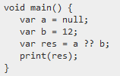

Slide 64
Dart Programming - Loops

Slide 65
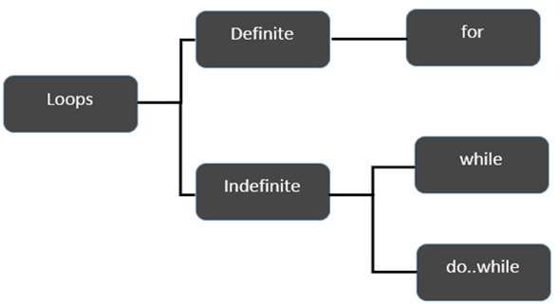
Loops
Loop statements are used to execute the block of code repeatedly for a specified number of times or until it meets a specified condition.
Notes:
At times, certain instructions require repeated execution. Loops are an ideal way to do the same. A loop represents a set of instructions that must be repeated. In a loop’s context, a repetition is termed as an iteration.

Slide 66
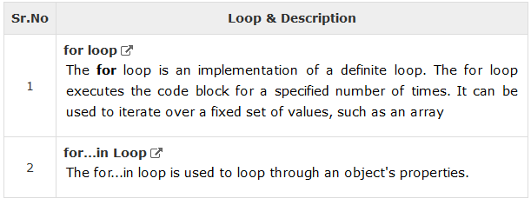
Definite Loop
A loop whose number of iterations are definite/fixed is termed as a definite loop.

Slide 67

for loop
The for loop executes the code block for a specified number of times. It can be used to iterate over a fixed set of values, such as an array.

Slide 68
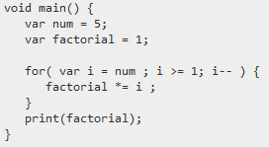
Notes:
The for loop has three parts: the initializer (i=num), the condition ( i>=1) and the final expression (i--).
The program calculates the factorial of the number 5 and displays the same. The for loop generates the sequence of numbers from 5 to 1, calculating the product of the numbers in every iteration.

Slide 69

for...in loop
The for...in loop is used to loop through an object's properties.

Slide 70
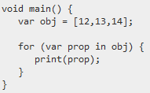


Slide 71
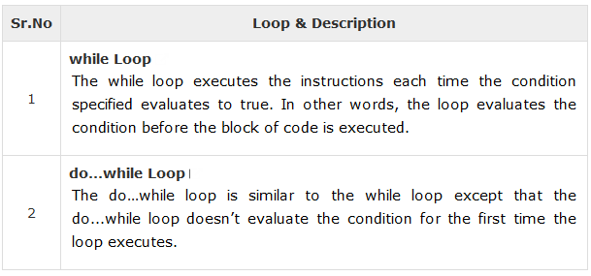
Indefinite Loop
Used when the number of iterations in a loop is indeterminate or unknown. Indefinite loops can be implemented using −

Slide 72

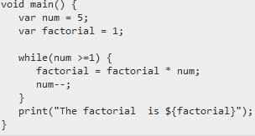
Notes:
The while loop executes the instructions each time the condition specified evaluates to true. In other words, the loop evaluates the condition before the block of code is executed

Slide 73

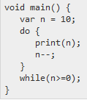
Notes:
The do…while loop is similar to the while loop except that the do...while loop doesn’t evaluate the condition for the first time the loop executes. However, the condition is evaluated for the subsequent iterations. In other words, the code block will be executed at least once in a do…while loop.
The following illustration shows the flowchart of the do…while l

Slide 74
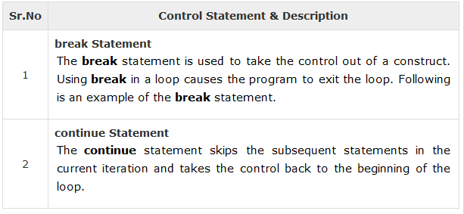
Loop Control Statements
Control flow statements allow us to break up the flow of code by employing decision-making, looping, branching and enabling our program to conditionally execute particular blocks of code

Slide 75
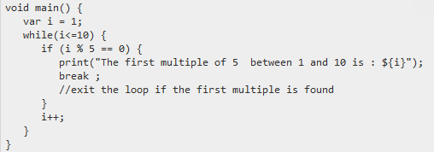
Notes:
The break statement is used to take the control out of a construct. Using break in a loop causes the program to exit the loop. Following is an example of the break statement.
The above code prints the first multiple of 5 for the range of numbers within 1 to 10.
If a number is found to be divisible by 5, the if construct forces the control to exit the loop using the break statement. The following output is displayed on successful execution of the above code.

Slide 76
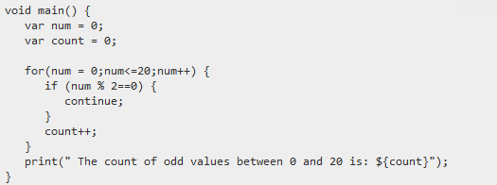
Notes:
The continue statement skips the subsequent statements in the current iteration and takes the control back to the beginning of the loop. Unlike the break statement, the continue statement doesn’t exit the loop. It terminates the current iteration and starts the subsequent iteration.

Slide 77
Dart Programming - Decision Making

Slide 78
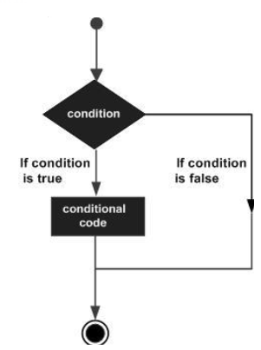
Conditional/Decision-Making
A conditional/decision-making construct evaluates a condition before the instructions are executed.

Slide 79
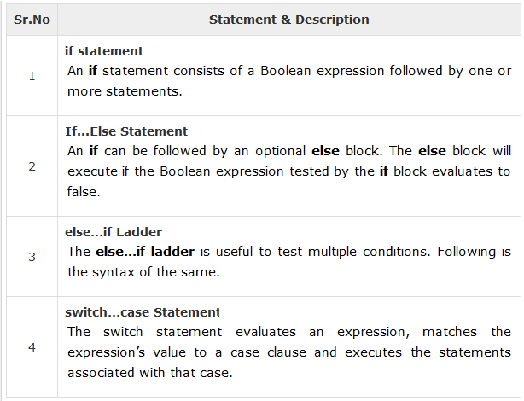
Conditional constructs in Dart are classified in the following

Slide 80

If statement
The if construct evaluates a condition before a block of code is executed.

Slide 81


Slide 82
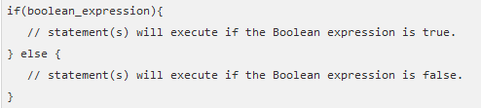
If … Else Statement
An if can be followed by an optional else block. The else block will execute if the Boolean expression tested by the if block evaluates to false.

Slide 83
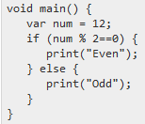

Slide 84
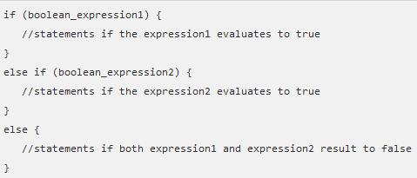
else…if ladder statement
The else…if ladder is useful to test multiple conditions. Following is the syntax of the same.

Slide 85
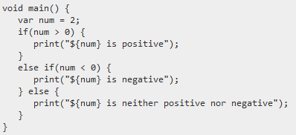

Slide 86
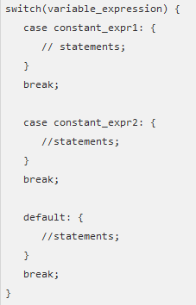
Switch Case Statement
The switch statement evaluates an expression, matches the expression’s value to a case clause and executes the statements associated with that case.

Slide 87


Slide 88


Slide 89
Assignment
Read about Dart OOP
Prepare for hands-on exam

Slide 90
Dart Functions and OOP

Slide 91
Functions
Functions are the building blocks of readable, maintainable, and reusable code. A function is a set of statements to perform a specific task. Functions organize the program into logical blocks of code. Once defined, functions may be called to access code.
Notes:
This makes the code reusable. Moreover, functions Functions allow a program to be broken down into callable units. A callable unit is a portion of code that can
be executed via an identifier (or “called”) from another, not necessarily related, part of a program. For example, you
may have a function that causes the computer to beep, logically called beep(). You may want the computer to beep
both when the user hits the wrong key and when the user has a new e-mail message. You can call the same beep()
function from both places. This saves you having to write the logic for doing the beep twice. It also keeps your code
well-organized.make it easy to read and maintain the program’s code.

Slide 92



Slide 93


Notes:
A function definition specifies what and how a specific task would be done. Before using a function, it must be defined. The syntax for defining a standard function is given below −

Slide 94
Function Name
Code
Notes:
A function definition specifies what and how a specific task would be done. Before using a function, it must be defined. The syntax for defining a standard function is given below −

Slide 95
Calling a Function
A function must be called to execute it. This process is termed as function invocation.

Slide 96


Slide 97

Returning Function Values
Functions may also return value along with the control, back to the caller. Such functions are called as returning functions.

Slide 98
Returning Function Values
The return_type can be any valid data type.
The return statement is optional. I not specified the function returns null;
The data type of the value returned must match the return type of the function.
A function can return at the most one value. In other words, there can be only one return statement per function.

Slide 99


Slide 100

Parameterized Functions
Functions can also have parameters. Parameters are a mechanism to pass values to functions. Parameters form a part of the function’s signature. The parameter values are passed to the function during its invocation.

Slide 101

Notes:
The following code snippet declares a function test_param with two parameters namely, n1 and s1
It is not mandatory to specify the data type of the parameter. In the absence of a data type, the parameters type is determined dynamically at runtime.
The data type of the value passed must match the type of the parameter during its declaration. In case the data types don’t match, the compiler throws an error.

Slide 102


Slide 103
Exercise C3-1
Create a function name findVolume that computes for the a tank using the following formula
Volume = length * breadth * height
https://www.jdoodle.com/execute-dart-online

Slide 104
Object Oriented Programming

Slide 105
Object-Oriented Programming
Object-oriented programming (OOP) is a programming language model in which programs are organized around data, or objects, rather than functions and logic.

Slide 106
What is an Object?
An object is an abstraction meant to represent a component of a program. Objects can be created, destroyed, given attributes, and made to perform actions.
Every object belongs to a class. The class of an object is its type. In other words, objects of the same class are the same type. Objects of the same class have the same instance variables and methods available to them (although the value of those instance variables may differ).

Slide 107
Class
a class is a blueprint for creating objects (a particular data structure), providing initial values for state (member variables or attributes), and implementations of behavior (member functions or methods).

Slide 108


Slide 109

Declaring a Class
se the class keyword to declare a class in Dart. A class definition starts with the keyword class followed by the class name; and the class body enclosed by a pair of curly braces. The syntax for the same is given below

Slide 110
Declaring a Class
A class definition can include the following −
Fields − A field is any variable declared in a class. Fields represent data pertaining to objects.
Setters and Getters − Allows the program to initialize and retrieve the values of the fields of a class. A default getter/ setter is associated with every class. However, the default ones can be overridden by explicitly defining a setter/ getter.
Constructors − responsible for allocating memory for the objects of the class.
Functions − Functions represent actions an object can take. They are also at times referred to as methods.

Slide 111

Notes:
The example declares a class Car. The class has a field named engine. The disp() is a simple function that prints the value of the field engine.

Slide 112
Creating Instance of the class
To create an instance of the class, use the new keyword followed by the class name. The syntax for the same is given below −
The new keyword is responsible for instantiation.
The right-hand side of the expression invokes the constructor. The constructor should be passed values if it is parameterized.

Slide 113


Slide 114

Dart Constructors
A constructor is a special function of the class that is responsible for initializing the variables of the class. Dart defines a constructor with the same name as that of the class. A constructor is a function and hence can be parameterized. However, unlike a function, constructors cannot have a return type. If you don’t declare a constructor, a default no-argument constructor is provided for you.

Slide 115


Slide 116
Named Constructors
Dart provides named constructors to enable a class define multiple constructors. The syntax of named constructors is as given below

Slide 117


Slide 118
The this Keyword
The this keyword refers to the current instance of the class. Here, the parameter name and the name of the class’s field are the same. Hence to avoid ambiguity, the class’s field is prefixed with the this keyword.

Slide 119


Slide 120
Dart Class ─ Getters and Setters
Getters and Setters, also called as accessors and mutators, allow the program to initialize and retrieve the values of class fields respectively. Getters or accessors are defined using the get keyword. Setters or mutators are defined using the set keyword.
Notes:
A default getter/setter is associated with every class. However, the default ones can be overridden by explicitly defining a setter/ getter. A getter has no parameters and returns a value, and the setter has one parameter and does not return a value.

Slide 121
Exercise C3-2
Create an class name Person with the following properties firstName, lastName, Age, Address.
Call each value of the properties using the following methods or functions: myAge, myName and myAddress,myCompleteInformation

Slide 122



Slide 123

Hands-On Exam

Slide 124
Solutions For Activity

Slide 125

Solution C3-1

Slide 126


Solution C3-2

